Slide 1
36
Common Currency Areas and European Monetary Union

Slide 2

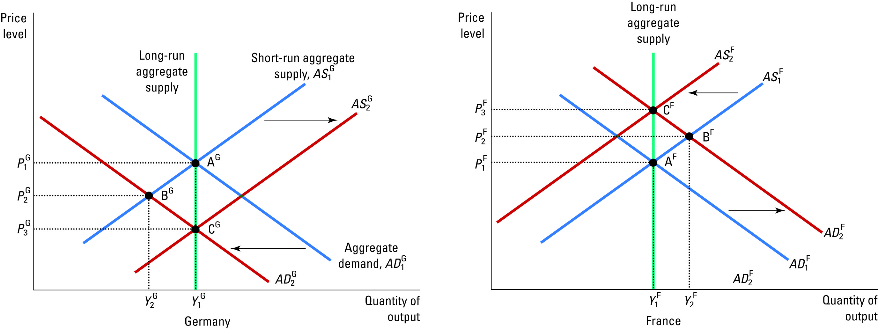
Figure 1 A Shift in Consumer Preferences Away from German Goods Towards French Goods
Copyright © 2004 South-Western

Slide 3
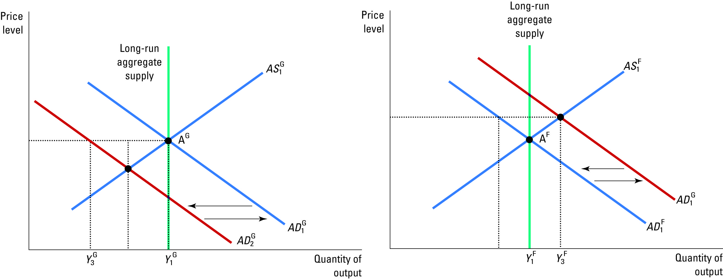
Figure 2 A Shift in Consumer Preferences with Flexible Exchange Rates
Copyright © 2004 South-Western

Slide 4

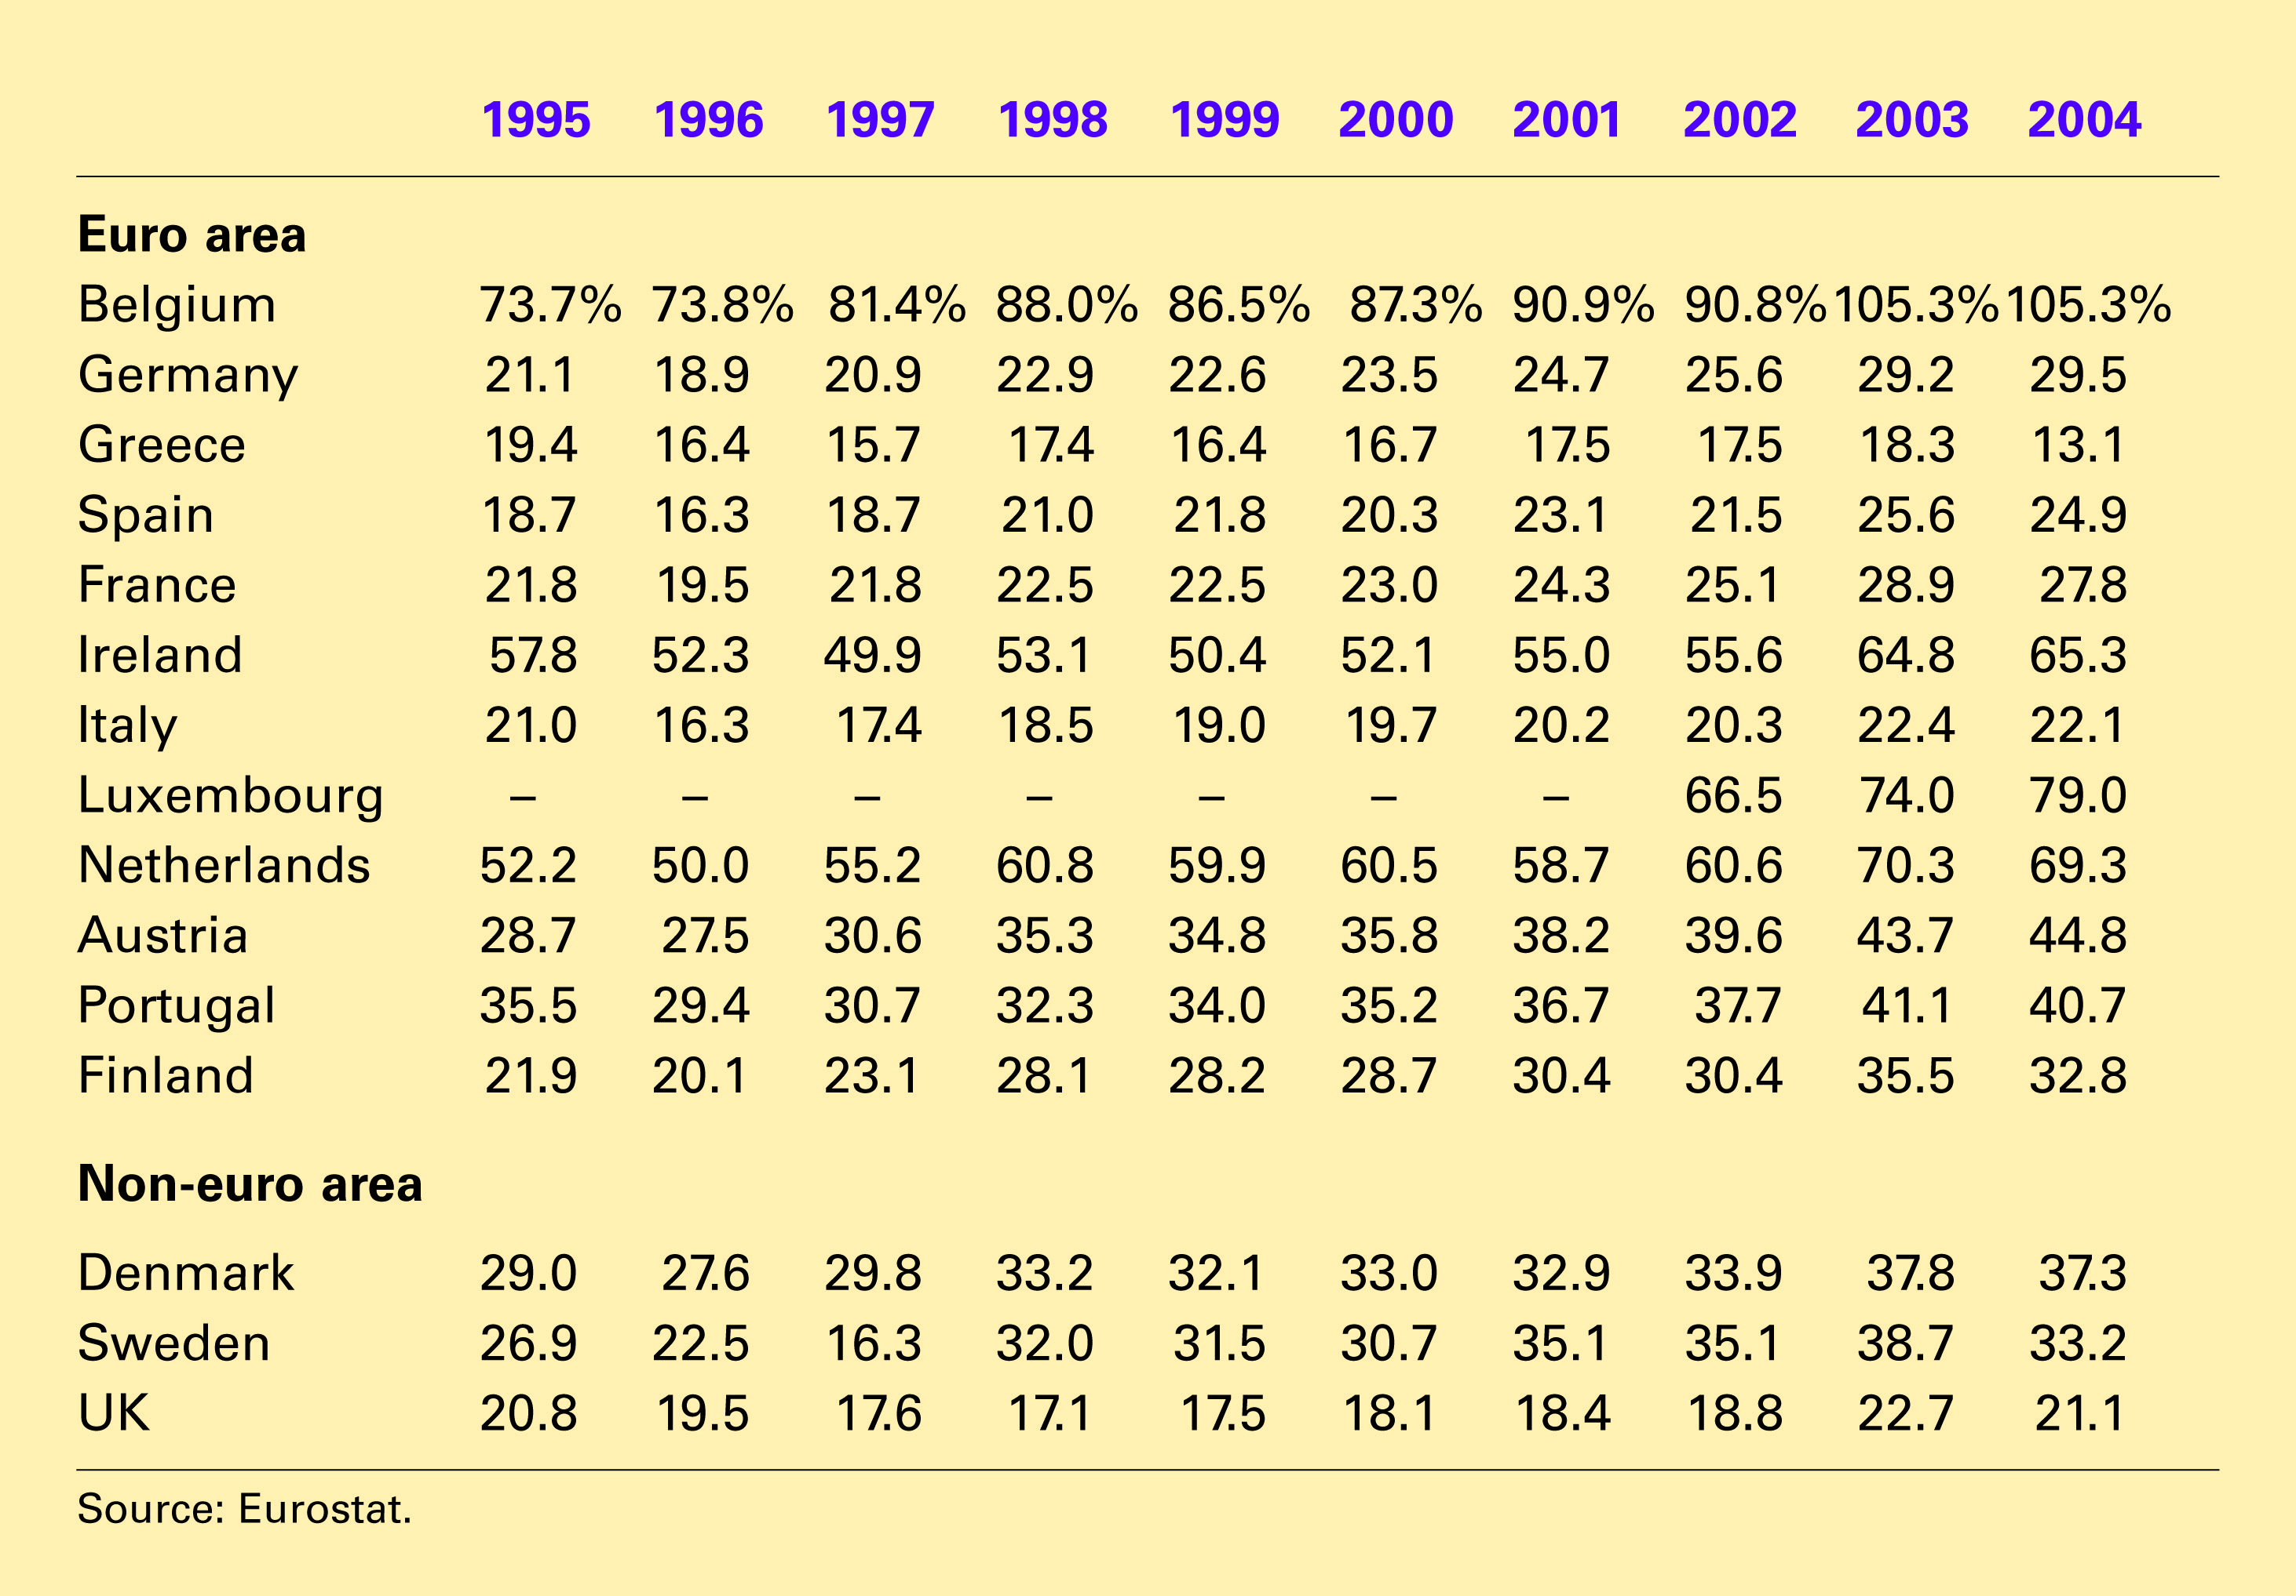
Table 1 Imports Plus Exports of 15 EU Countries From and To Other EU Countries as a % of GDP
Copyright©2004 South-Western

Slide 5
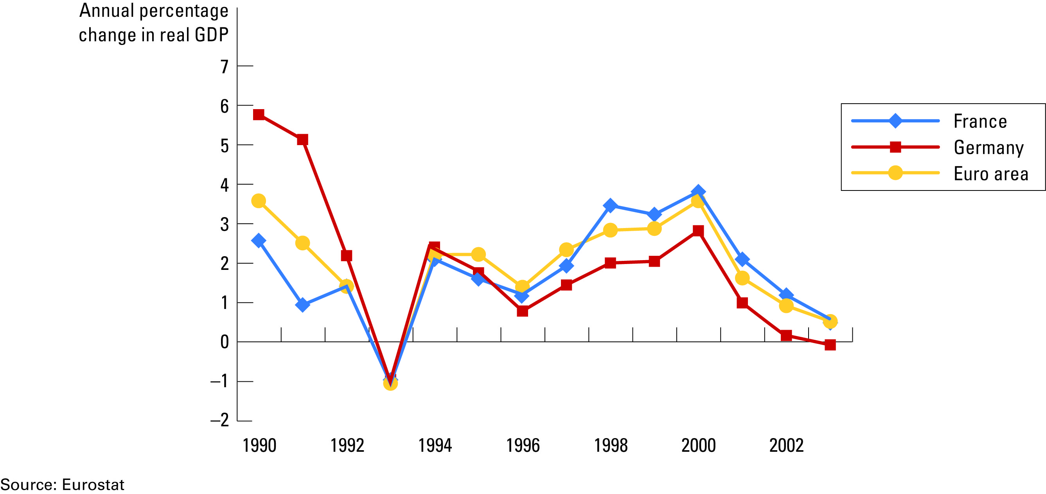
Figure 3 Growth Rates in Germany, France and the Whole Euro Area
Copyright © 2004 South-Western

Slide 6
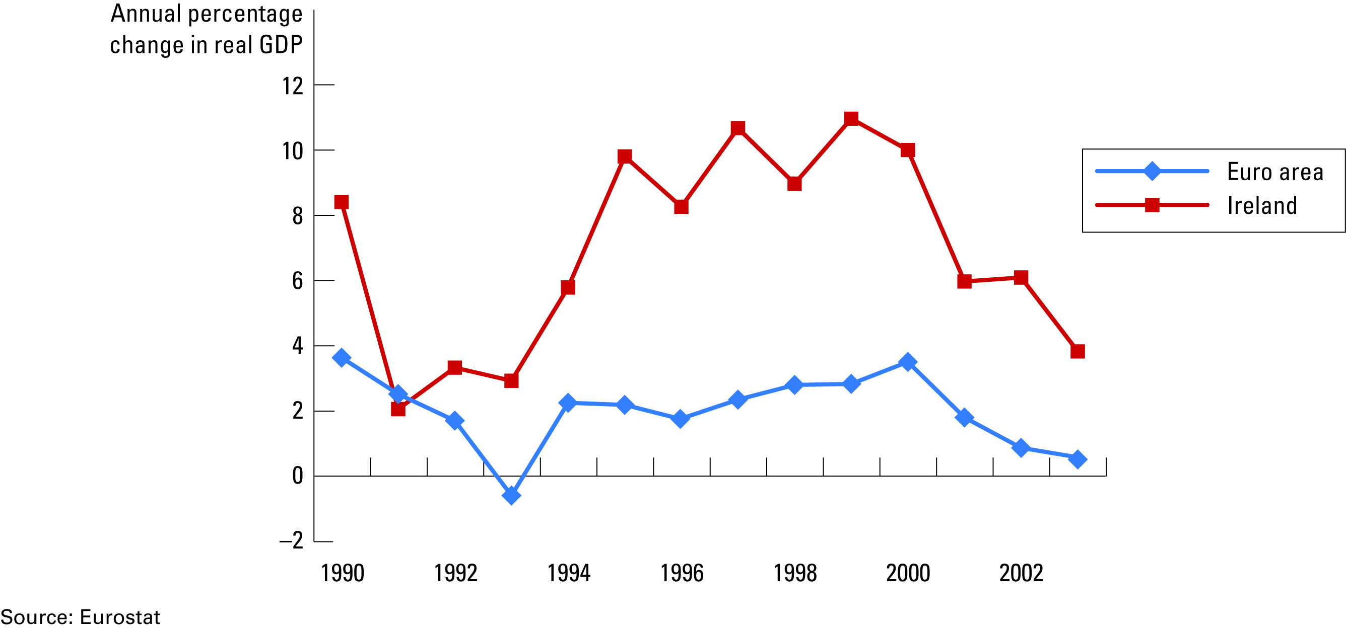
Figure 4 Growth Rates in Ireland and the Whole Euro Area
Copyright © 2004 South-Western

